Slide 1

Liferay Portal
Day 1

Slide 2
Agenda
Portal
Liferay Portal
Why Liferay
Features of Liferay
Liferay Plugins
Portlets
Themes
Layouts
Hooks
Ext
Liferay portal setup for development
DB Setup

Slide 3
PORTAL

Slide 4

Why Portal Application and Not Web Application

Slide 5
What is portal?
It is again web application but it is portal application.
Personalization
Aggregation
Authentication

Slide 6
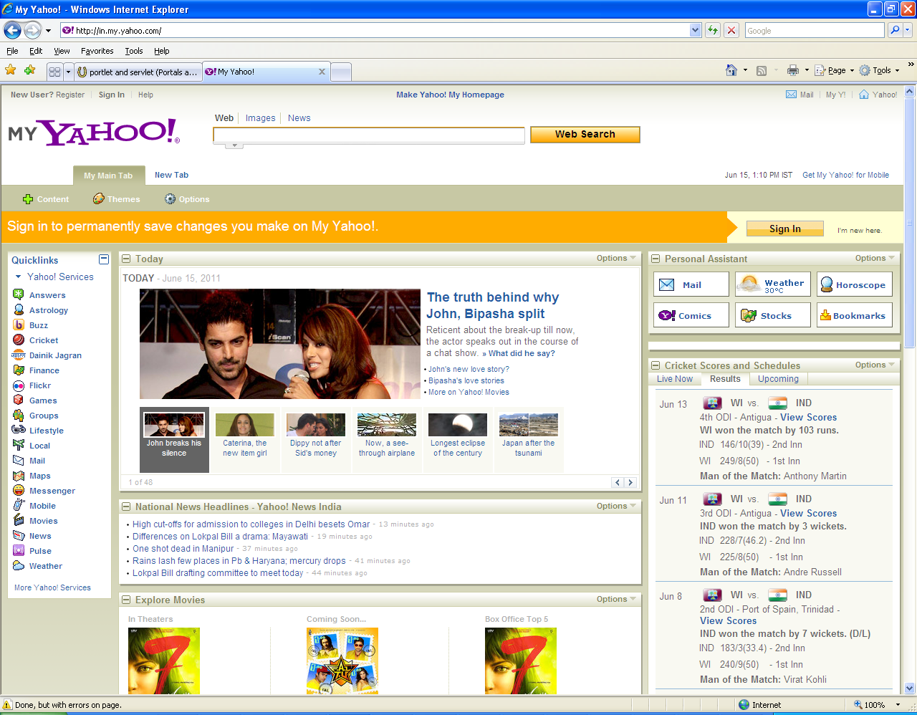
My Yahoo

Slide 7
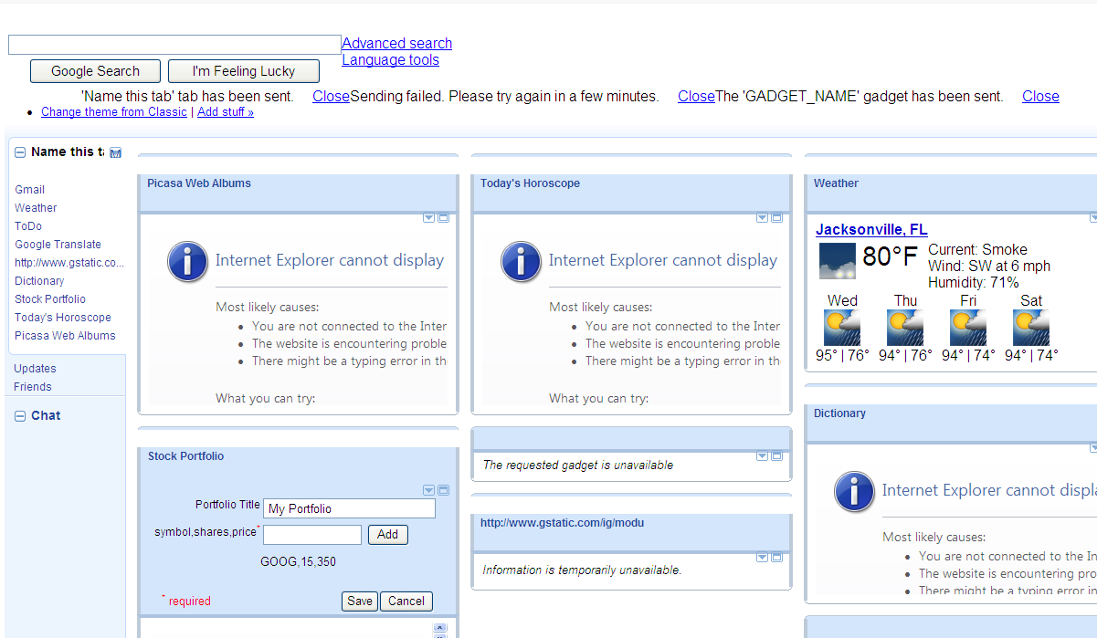
igoogle

Slide 8
LIFERAY PORTAL

Slide 9
Liferay Portal
Liferay Portal is the world's leading open source enterprise portal solution using the latest in Java and Web technologies
Liferay Portal is most popular portal technologies with an ever-growing list of features that helps to implement solutions with minimal time and effort.

Slide 10
Liferay Portal (contd…)
Any Database:
Liferay supports several popular databases IBM DB2, Apache Derby, MySQL, Informix, SQL Server, Sybase, and others.
Any Server :
Some of the popular free servers bundled with Liferay are:
Geronimo
GlassFish
Jboss
Jetty
JonAS
Pramati
Resin
Tomcat
Weblogic
Websphere… etc.,
Any Framework :
Spring, iBatis, Hibernate, Struts, Groovy, etc.,

Slide 11
Why Liferay
For multi framework based portal application
For fast development
For collaboration, internationalization

Slide 12
Features of Liferay
Runs on all major application servers and servlet containers, databases, and operating systems, with over 700 deployment combinations.
JSR-286 Compliant : main features of JSR -286 are:
IPC (Inter Portlet Communication)
JSON ( Java Script Object Notation) : Invoking a web service via JavaScript
Out-of-the-box usability with over 60 portlets pre-bundled.
Built in Content Management System (CMS) and Collaboration Suite
Personalized pages for all users
Easy one click configuration
Internationalization Support
Liferay provides excellent support for internationalization. You can easily support languages such as Arabic, german, spanish, French… etc.,

Slide 13
LIFERAY PLUGINS

Slide 14
Liferay Plugins
Liferay has five type of plugins.
Portlets
Themes
Layouts
Hooks
EXT

Slide 15
Liferay Plugins - (Contd…) - Portlets
Portlets:
Web Application
provides a specific piece of content (information or service) to be included as part of a portal page
managed by a portlet container which
i. Processes requests
ii. & generates dynamic content
content generated by a portlet is also called a fragment
Portlet 1.0 JSR-168
Portlet 2.0 JSR-286
The Java™ Specification Request Portlet Specification standardizes how components should be developed for a portal server

Slide 16
Liferay Plugins - (Contd…) - Portlets
Portlet Life Cycle Methods:
Init
Render
ProcessAction
ProcessEvent
ServeResource
Destory

Slide 17
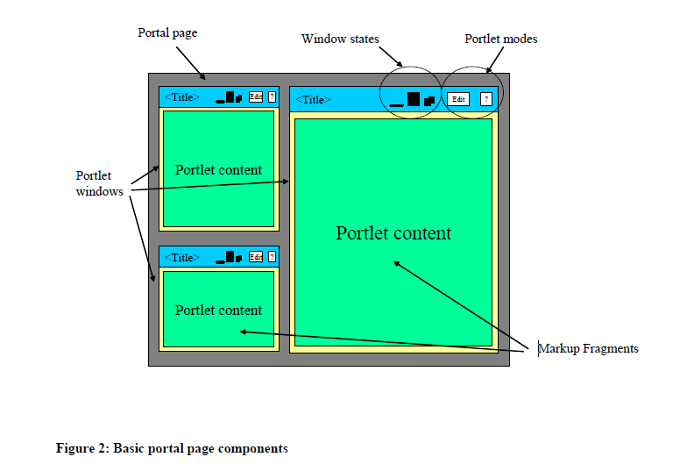
Liferay Plugins - (Contd…) - Portlets
Portlet Modes and Window States
Modes:
VIEW, EDIT and HELP
Window States:
Maximized, Minimized and Normal

Slide 18
Liferay Plugins - (Contd…) - Portlets
Portlet Preferences
Portlets are configured or coded to provide a customized view or behavior to different users
persistent set of name-value pairs – Portlet preferences
Using PortletPreferences interface via the getValues() and setValues() methods,portlet container will be retrieving and storing portlet preferences
Example –
PortletPreferences prefs = rReq.getPreferences();
String unit = prefs.getValue("unit","F");
prefs.setValue("zip",zip);

Slide 19
LIFERAY PORTAL SETUP

Slide 20
Liferay Portal Setup - Development
Prerequisite:
Java
Liferay IDE
Liferay Plugin SDK
Liferay Portal Tomcat Server Bundle
Download all the above and keep ready in your local machine.

Slide 21
Initial steps and folder structures.
Install Java and Set Classpath with JAVA_HOME
Extract Liferay IDE
Create Folder as lrworkspace in C:/ Drive
Extract Liferay Plugin SDK and place it under “lrworkspace” folder as called “plugins”
Extract Liferay Portal Tomcat bundle and place it under “lrworkspace” folder as “server”
Open Liferay IDE and start configuring Liferay Plugin SDK and Liferay Portal Server Wizard.

Slide 22
DB Setup
Install MySQL and Create Database schema as”lrportal”
Under server bundle/webapps/ROOT/WEBINF/classes folder, Create portal-ext.properties file and add below properties.
jdbc.default.driverClassName=com.mysql.jdbc.Driver
jdbc.default.url=jdbc:mysql://localhost/lrportal?useUnicode=true&characterEncoding=UTF-8&useFastDateParsing=false
jdbc.default.username=xxx
jdbc.default.password=xxx

Slide 23
Oh My God…… I forgot to show one slide….. Do you know What?

Slide 24

I can able to read your mind !!!!!!!!

Slide 25


Slide 26
When he will finish it up?

Slide 27





Slide 28

The END

